Slide 1


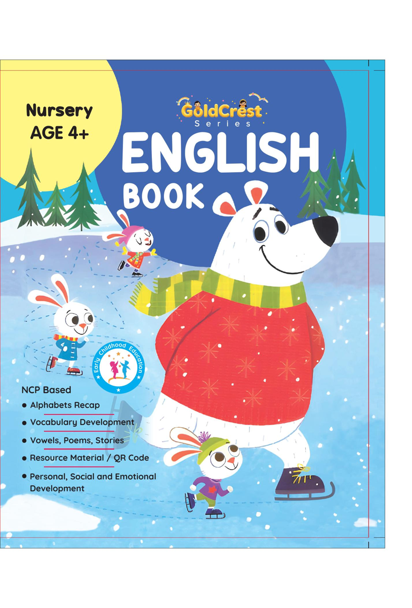
GoldCrest English Book
Nursery • Age 4+
An activity-based early-years book from the GoldCrest Series.
A Project of Azhar Publishers & Book Factory

Slide 2
i
What's Inside
GoldCrest English Book Nursery • Age 4+
1
Alphabet A–Z recap with pictures
2
Vowels and their sounds
3
Capital and small letters
4
Vocabulary building
5
Rhymes, poems and short stories
6
Personal, social & emotional development

Slide 3
★
Purpose & Classroom Support
Builds early English literacy — letter recognition, phonics and reading readiness — while growing vocabulary and confidence.
“
Every book comes with
1
2
3
Teacher's Lesson Plan
Practice Papers
Digital Interactive Version
A 40-week lesson plan that guides teachers, day by day.
Monthly tests and term exam papers for children to attempt.
An interactive flipbook and digital exercises for engaging, screen-based practice.
A Project of Azhar Publishers & Book Factory

